Slide 1
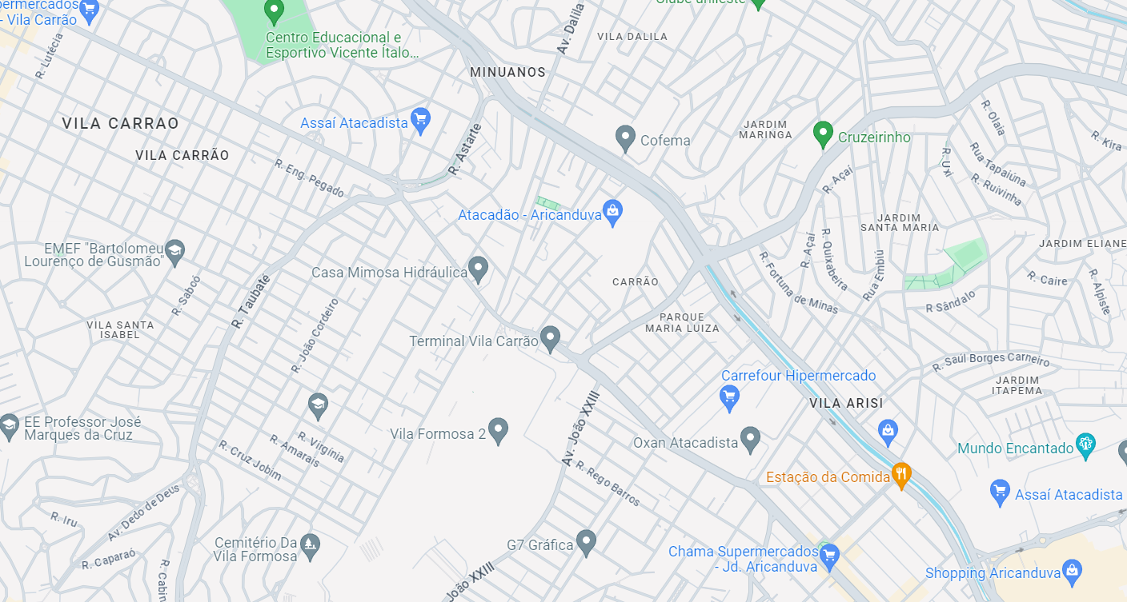

Luan Souza
Atacadão

